Slide 1
Winter Term 21/22 Graph Neural Networks Applications & Link to Graph Queries Org & Introduction
Prof. Dr. Holger Giese (holger.giese@hpi.uni-potsdam.de)
Christian Medeiros Adriano (christian.adriano@hpi.de) - “Chris”
Matthias Barkowsky (matthias.barkowsky@hpi.de)

Slide 2
Key Facts
Weekly Hours: 4
Credit Points: 6
Teaching Form: Project Seminar
Enrolment Type: Compulsory Elective Module (“Wahlpflichtmodul”)
Course Language: English
Study Programs and Modules:
IT-Systems Engineering MA
Mandatory module : „IT-Systems Engineering Analysis“
Mandatory module: „IT-Systems Engineering Design“
Specialization module(s): „Software Architecture & Modeling Technology“
Data Engineering MA
Digital Health MA

Slide 3
Dates
Enrollment deadline: 22.10.2021
Cancellation deadline for enrollment: 30.01.2022
Introductory meeting: 27.10.2021 [NOW]
Meetings:
Lectures - scheduled
Update meetings – on demand, usually weekly
Final Presentations at end of the semester: To be decided
We will be present at the lecture room, but we will also be joining via Zoom.

Slide 4
Communicantion Plan
Motive | Content | Medium
Artifacts | Source code, Data Documentation, Wiki | Github - https://github.com/orgs/hpi-sam/
Papers | Copyrighted material | Bib-Admin
Messaging ad hoc | Questions, Suggestions, Sharing | Our Slack group: graph-neural-networks.slack.com
Official communications | Schedule, Orientations, Administrative issues | Email christian.adriano@hpi.de
Meetings | Lectures, Status, Work meetings | Zoom, Skype
Emergency | Call, SMS, messaging | Chris mobile number (check Chris’ Slack profile)

Slide 5
Seminar Work, Deliverables and Grading
Work alone or in groups on one selected topic/project.
Each team has on-demand update meetings with teaching assistant.
Project Execution: [60% of final grade]
Weekly update meeting
Intermediary Presentations
Written deliverables: [30% of final grade]
Final report on findings
Length: approx. 10 pages ACM Format per team participants
Some parts must be attributable to each individual author
Final Presentations: [10% of final grade]
Presentation on findings
Questions and feedback for other students' presentation

Slide 6
Road Map (1/2)
Intro and Course Organization
Graph Metrics and Random Models
Graph Structural Features – Clustering
Message Passing & Belief Propagation
Graph Embeddings - Message Passing
PageRank & Markov Chains & Graph Queries
Graph Convolutional Networks
Graph Attention Networks
Graph Evolution Networks
Temporal Graph Networks
Deep Graph Generative Models
Causal Graph Neural Networks
Propagation Graph Neural Networks
Network Effects, Cascading and Contagion
Outbreak Detection and Influence Maximization
Week-1
Organization
Objectives
Team building, Setup, Topic
Week-2
Description and Feature models
Understand a phenomenon
Extract features
Establish baselines
Preprocessing data
Week-3
Basic
Prediction models
Predict an outcome
ML architecture and pipeline
Training models
Evaluation models
Week-4
Advanced Prediction models
Effects of interventions
Risks of confounding
Causal structure
Week-5
Generative and
Intervention models

Slide 7
Roadmap (2/2)
Project Phase 1: Learn fundamentals - Lectures
Goal: learn fundamentals
Deadline: Mid-End of December
Project Phase 2: Present Proposal - Reading and Writing
Goal: learn about the state of art of one application area
Project Phase 3: Apply a method - Coding and Evaluation
Goal: learn to apply and evaluate a method
Present update in weekly meetings
Final Presentations in one session in February 2022
Submission of final report one week after the presentation

Slide 8
Project Proposal
Team size: up to four people.
Project proposal in two stages:
1- State-of-art (one page, double column) – in 6 weeks (First week of December)
Each person covers at least five well-selected papers (group covers at least 20 papers)
2- Plan - first draft in 8 weeks (before New Years Break)
Detail the problem (what is it? why should I care?, why is it challenging?)
Describe the dataset (source, size, main features, cite any papers that used it)
Determine the metrics and algorithms to be used (preliminary insights, it might change)
Discuss how you will evaluate your results (benchmarks and baselines)

Slide 9
Datasets and Tools
Datasets
http://networkrepository.com/
https://snap.stanford.edu/data/
https://networkdata.ics.uci.edu/
Tools (sorted by priority)
cuGraph: https://github.com/rapidsai/cugraph (Strongly recommend, fast)
NetworkX: https://networkx.org/documentation/stable/tutorial.html (great coverage of graph algorithms)
Snap for Python: http://snap.stanford.edu/snappy/index.html
Pytorch Geometric: https://pytorch-geometric.readthedocs.io/en/latest/
Github project: https://github.com/orgs/hpi-sam/projects/3

Slide 10
Motivation for Learning on Graphs and GNNs

Slide 11
Scenarios and Network Types
Network Types
Event graphs
Disease pathways
Knowledge-graphs
Scene graphs
Heterogeneous graphs (different types of nodes and edges)
Scenarios
Clustering in social network
Protein interaction
Cell similarity networks
Failure propagation in infrastructure networks
Fake news detection
Side-effects of drugs
Network attacks
Traffic jams

Slide 12
Types of Predictions
Node classification
What type of node is this?
Link prediction
Are these two nodes connected?
With which strength?
Graph Classification
Patterns of connectivity (motifs)
Network similarity (isomorphism)
Notes:
Leskovec, Jure, et al. "Community structure in large networks: Natural cluster sizes and the absence of large well-defined clusters." Internet Mathematics 6.1 (2009): 29-123.

Slide 13
Basic Concepts

Slide 14
Types of graphs
Directed
Undirected
Disconnected
Fully connected
A
A
A
A
B
B
B
B
C
C
C
C
D
D
D
D
Directed Acyclic Graph
Multigraph
Bipartite
Cliques
E
A
A
A
A
B
B
B
F
B
C
C
C
D
D
D
C
D
Ego network of A

Slide 15
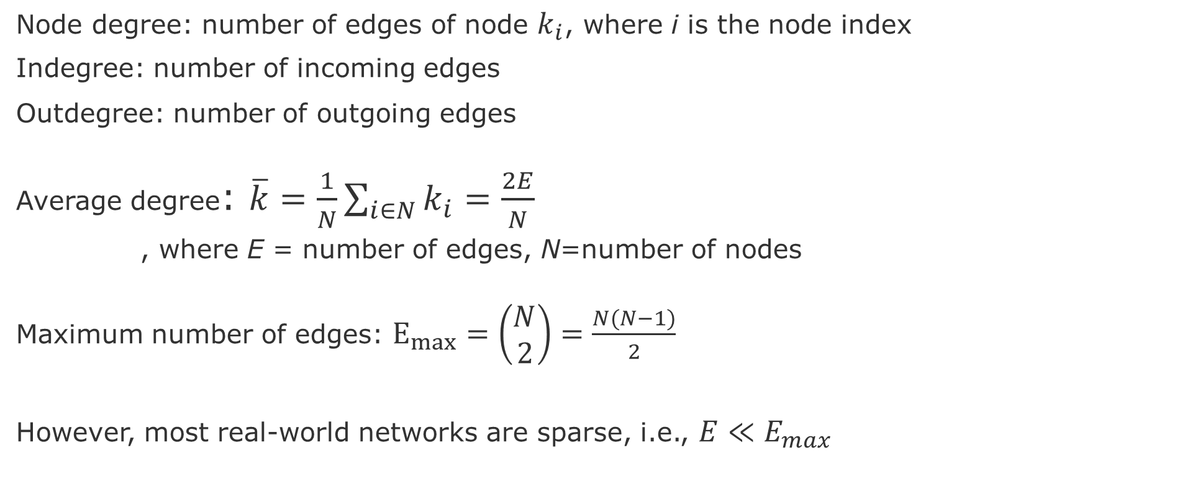
Node and Edge degrees
Node degree: number of edges of node $k_{i}$, where i is the node index
Indegree: number of incoming edges
Outdegree: number of outgoing edges
Average degree: $\overline{k}=\frac{1}{N}\sum_{i∈N}{k_{i}}=\frac{2E}{N}$
, where E = number of edges, N=number of nodes
Maximum number of edges: $E_{max}=\left(\begin{aligned}N \\ 2\end{aligned}\right)=\frac{N(N−1)}{2}$
However, most real-world networks are sparse, i.e., $E≪E_{max}$
Notes:
Leskovec, Jure, et al. "Community structure in large networks: Natural cluster sizes and the absence of large well-defined clusters." Internet Mathematics 6.1 (2009): 29-123.

Slide 16
Adjacency matrix
 | A | C | D | B | E | F
A | 1 | 1 | 1 | 1 | 0 | 0
C | 1 | 0 | 1 | 1 | 0 | 0
D | 1 | 1 | 0 | 1 | 0 | 0
B | 1 | 1 | 1 | 0 | 1 | 1
E | 0 | 0 | 0 | 1 | 0 | 1
F | 0 | 0 | 0 | 1 | 1 | 0
Cliques
E
A
F
B
C
D
However, adjacency matrix of real-world networks are full of zeros

Slide 17
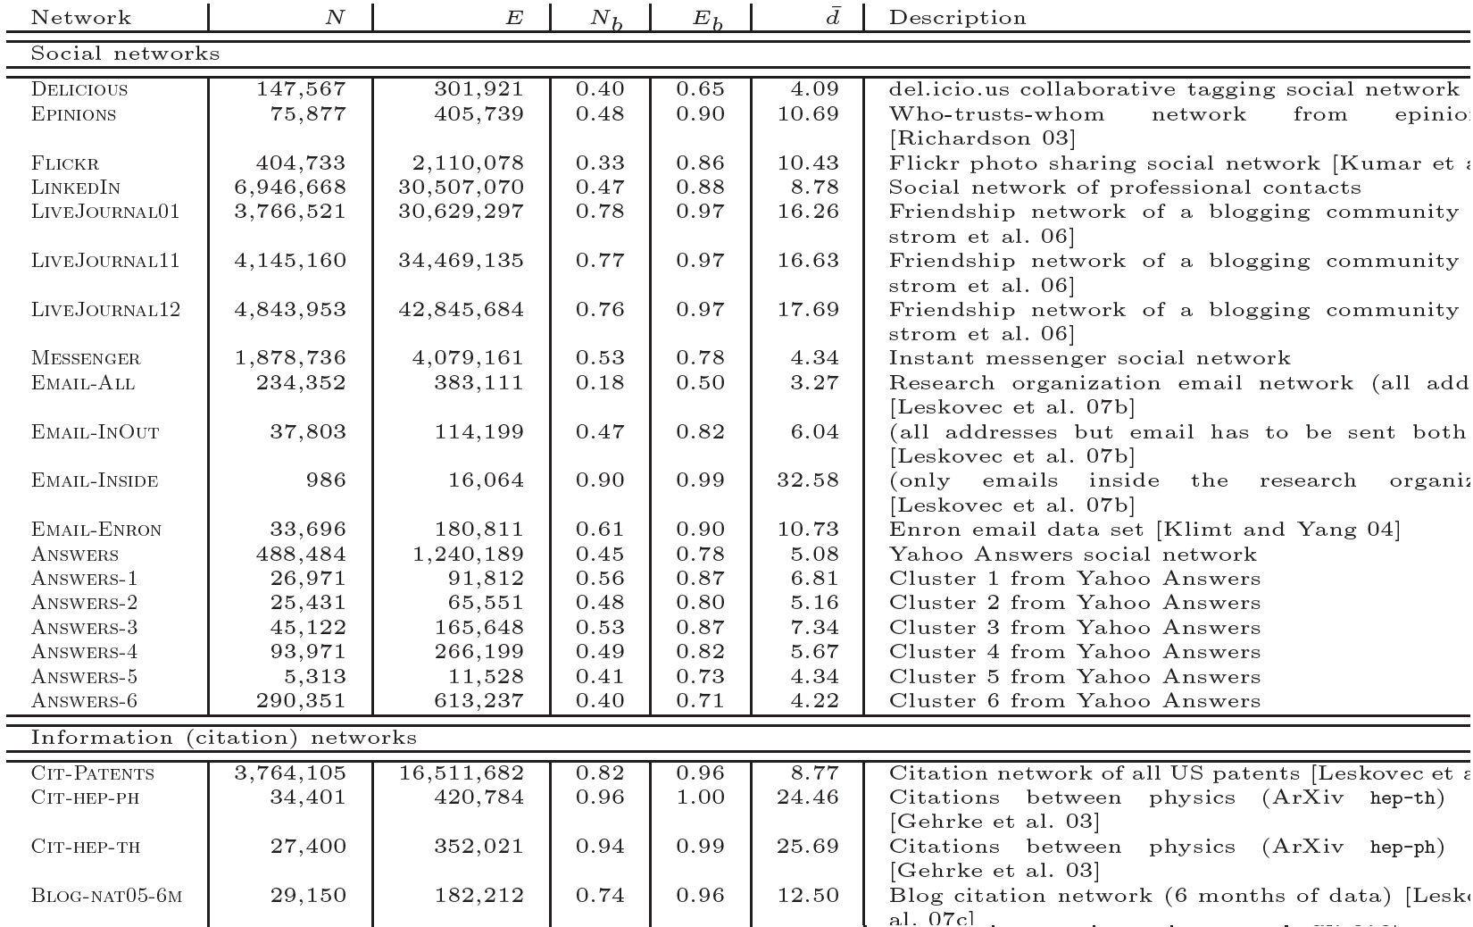
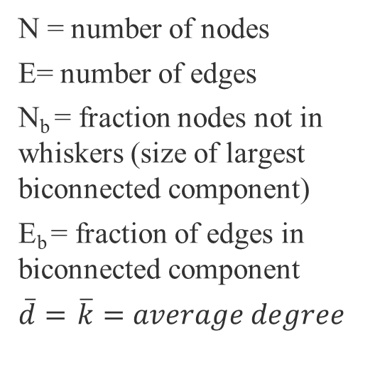
Most real-world networks are sparse
N = number of nodes
E= number of edges
N_{b} = fraction nodes not in whiskers (size of largest biconnected component)
E_{b} = fraction of edges in biconnected component
$\overline{d}=$ $\overline{k}=average degree$
source :Leskovec, J., et al. "Community structure in large networks: Natural cluster sizes and the absence of large well-defined clusters." Internet Mathematics 6.1 (2009): 29-123.

Slide 18
END

